Slide 1





BIG DATA TRACK · FINAL PROJECT
THE STACK
NYC Traffic & Mobility Analytics
Hadoop HDFS
Distributed storage
Apache Spark
Distributed ETL
Apache Airflow
An end-to-end Big Data pipeline for NYC taxi trips: HDFS · Spark · Airflow · ClickHouse · Superset
Orchestration
ClickHouse
Analytical database
NTI – Huawei Egyptian Talents Academy
Apache Superset
Big Data Track
Dashboard
Farouk Sameh · Ziad Sherif · Mostafa Ahmed · Gaber Tahoon
Instructor: Ahmed Saeed
Notes:
Good morning everyone. We are presenting NYC Traffic & Mobility Analytics, our final project in the NTI – Huawei Egyptian Talents Academy Big Data Track, under Ahmed Saeed. It is an end-to-end Big Data pipeline: raw NYC taxi data goes through HDFS, Spark, ClickHouse and Superset, with Airflow orchestrating the ETL and Docker running everything. The panel on the right is the stack we will walk through.

Slide 2

Project Overview
PROJECT
An end-to-end Big Data analytics pipeline for NYC taxi trip data.
Distributed storage
HDFS holds raw, staging and processed data
The system processes large-scale trip data with distributed storage and distributed processing, stores the processed analytical data in ClickHouse, and visualizes the results through Apache Superset.
Distributed processing
Spark ETL cleans, transforms and aggregates the trips
Analytics & visualization
ClickHouse serves queries to the Superset dashboard
Containerized with Docker · Orchestrated by Apache Airflow
Notes:
In one sentence: we built an end-to-end Big Data analytics pipeline for NYC taxi trip data. Data is stored and processed in a distributed way using HDFS and Spark. The processed analytical data is loaded into ClickHouse and visualized through Apache Superset. The whole environment is containerized with Docker and the ETL workflow is orchestrated by Airflow.

Slide 3




Problem & Objectives
WHY WE BUILT IT
THE PROBLEM
OUR OBJECTIVES
Taxi trip data is massive, and single-machine tools struggle to process it
1
Store raw and processed data in distributed storage (HDFS)
2
Clean, transform and aggregate with distributed ETL (Spark)
Raw trips are not ready for analysis until cleaned and aggregated
3
Automate and validate the workflow (Airflow)
Zones appear as numeric IDs that are hard to interpret
4
Serve fast analytical queries (ClickHouse)
Manual, repeated steps make results hard to reproduce
5
Deliver an interactive, readable dashboard (Superset)
Notes:
Why did we build this? Taxi trip data is very large, and single-machine tools struggle with it. Raw trips are not ready for analysis, zones appear only as numeric IDs, and manual repeated steps make results hard to reproduce. So our objectives were: distributed storage, distributed ETL, an automated and validated workflow, fast analytical queries, and an interactive dashboard with readable zone names.

Slide 4

Overall Architecture
ARCHITECTURE
Streamlit
Interactive trip duration and fare predictor
ML APP
Apache Airflow
Orchestration
Apache Superset
Interactive dashboard with KPIs, charts and filters
VISUALIZATION
check_hdfs
ClickHouse
default.zone_hour for fast OLAP queries
check_spark
ANALYTICAL DB
preflight_staging
Apache Spark
Distributed ETL: clean, transform, aggregate
PROCESSING
run_etl
Hadoop HDFS
Raw, staging and processed data in /data/nyc
validate_staging
STORAGE
Docker
Every service runs as a container: consistent, isolated and reproducible
Notes:
This is the architecture as layers. At the bottom is HDFS for storage. Above it is Spark for processing. Then ClickHouse as the analytical database, and Superset at the top for visualization. Data flows upward through these layers. On the right, Airflow orchestrates the ETL as five dependent tasks, and underneath everything, Docker containerizes all services. The Streamlit app on top is our interactive ML trip predictor.

Slide 5
Technologies Used (1/2)
TECHNOLOGIES
TECHNOLOGY
WHAT DOES IT DO?
WHY DID WE USE IT?
Docker
Containerizes the complete Big Data environment
Many distributed services: isolated, consistent and reproducible setup
Containerization
Hadoop HDFS
Stores raw, staging and processed data across nodes
Designed for large datasets, with fault tolerance
Distributed storage
Apache Spark
ETL: data cleaning, transformation and aggregation
Faster and more flexible than single-machine processing; reads Parquet on HDFS directly
Distributed processing
Apache Airflow
Automates the ETL workflow and its task dependencies
Validates infrastructure and output; reproducible, manageable pipeline
Orchestration
Notes:
Every technology answers two questions: what does it do, and why did we use it. Docker containerizes the whole environment, which matters because we run many distributed services and need a reproducible setup. HDFS is our distributed storage: built for large datasets with fault tolerance. Spark does the ETL, and is faster and more flexible than single-machine processing while working natively with Parquet on HDFS. Airflow automates the workflow, controls dependencies and validates infrastructure and output.

Slide 6

Technologies Used (2/2)
TECHNOLOGIES
TECHNOLOGY
WHAT DOES IT DO?
WHY DID WE USE IT?
ClickHouse
Serves fast analytical queries over the processed data
Optimized for OLAP: very fast aggregations behind the dashboard
Analytical database
Apache Superset
Interactive dashboards and charts for data exploration
Open-source BI platform with filters and easy exploration
Visualization
Python / Pandas / SQL
Python for ETL and ML scripts, Pandas for data inspection, SQL for queries
One ecosystem for processing, preparation, validation and ClickHouse queries
Analytics toolkit
Streamlit
Interactive web app for trip duration and fare predictions
Turns our Python ML models into a simple, usable interface
ML web app
Notes:
ClickHouse is our analytical database, optimized for OLAP workloads, so aggregation queries behind the dashboard are very fast. Superset is the open-source BI platform that gives us interactive charts and filters. Python, Pandas and SQL tie it together: Python for ETL and machine learning scripts, Pandas for inspection and preparation, and SQL for aggregations, validation and ClickHouse queries. Streamlit powers our interactive trip predictor app. Kafka appears only in our future work.

Slide 7


Data Pipeline
DATA FLOW
Apache Airflow
check_hdfs → check_spark → preflight_staging → run_etl → validate_staging
Orchestration layer
Raw NYC Taxi Data
HDFS
Apache Spark
Processed Parquet
ClickHouse
Superset
Trip records in Parquet
Raw storage at /data/nyc/raw
ETL: clean, transform, aggregate
Stored in HDFS and loaded to ClickHouse
Analytical storage: zone_hour
Interactive dashboard
STORE
PROCESS
SERVE & VISUALIZE
All services run as Docker containers.
Notes:
This is the data flow. Raw NYC taxi data lands in HDFS. Spark reads it, runs the ETL, and writes processed Parquet. That processed data is kept in HDFS and loaded into ClickHouse, which is our analytical storage. Superset connects to ClickHouse for the dashboard. Airflow sits above the pipeline: its tasks check HDFS and Spark, run the ETL and validate the output, shown by the dashed green connectors.

Slide 8



HDFS – Distributed Storage
STORAGE LAYER
RAW · SOURCE DATA
HDFS ARCHITECTURE (CONCEPTUAL)
/data/nyc/raw
NameNode
STAGING · INTERMEDIATE OUTPUT
/data/nyc/staging
File system metadata
PROCESSED · ANALYTICAL DATA
/data/nyc/processed
DataNode 1
DataNode 2
DataNode 3
Block 1
Block 2
Block 3
Distributed storage
Scalability
Data spread across nodes
Grows by adding nodes
Block 2
Block 3
Block 1
Fault tolerance
Big Data storage
Blocks replicated across nodes
Built for very large datasets
Files are split into blocks and replicated across DataNodes
Notes:
HDFS is our distributed storage layer. We organize it into three paths: /data/nyc/raw for the source data, /data/nyc/staging for intermediate output, and /data/nyc/processed for the cleaned and aggregated data. HDFS gives us distributed storage, scalability, fault tolerance and storage designed for Big Data. The illustration on the right is a simplified, conceptual view: a NameNode holds metadata, and files are split into blocks replicated across DataNodes.

Slide 9

Spark – Distributed ETL
PROCESSING LAYER
1
2
3
4
5
6
Read raw Parquet from HDFS
Clean the data
Transform columns
Prepare trip-level data
Generate hourly zone aggregations
Write processed data to HDFS
ETL FLOW
MAIN ETL SCRIPTS
HDFS raw
Apache Spark
HDFS processed
etl_clean.py
/data/nyc/raw
Processing engine
/data/nyc/processed
etl_clean_staging.py
Notes:
Spark is the processing engine between the raw and processed data. The ETL has six steps: read raw Parquet from HDFS, clean the data, transform columns, prepare trip-level data, generate hourly zone-level aggregations, and write the processed data back to HDFS. The main scripts are etl_clean.py and etl_clean_staging.py. Spark was the right choice because it handles large datasets in a distributed way and works directly with Parquet and HDFS.

Slide 10





Airflow – Workflow Orchestration
ORCHESTRATION LAYER
check_hdfs
check_spark
preflight_staging
run_etl
validate_staging
Validate HDFS availability
Validate Spark availability
Pre-flight check on staging
Run the Spark ETL
Validate the ETL output
PRE-FLIGHT CHECKS
PROCESSING
VALIDATION
WHY ORCHESTRATION MATTERS
airflow/dags/nyc_traffic_pipeline.py
Dependency management
Automation
Monitoring
Validation
Reproducibility
Tasks run in the right order
Runs without manual steps
Task status is visible in Airflow
Checks before and after the ETL
Same workflow on every run
Notes:
Airflow orchestrates the ETL as a DAG defined in airflow/dags/nyc_traffic_pipeline.py. Five tasks run in order: check_hdfs, check_spark and preflight_staging validate the infrastructure before processing; run_etl executes the Spark job; validate_staging checks the output afterwards. Orchestration matters because it gives us dependency management, automation, monitoring, validation and a reproducible pipeline.

Slide 11



ClickHouse – Analytical Storage
ANALYTICAL LAYER
default.zone_hour
WHY CLICKHOUSE?
Fast analytical queries
pu_zone
Pickup zone
Efficient for dashboard queries
pickup_date
Pickup date
pickup_hour
Pickup hour
Aggregation performance
trips
Number of trips
Very fast aggregations over large tables
avg_fare
Average fare
Built for OLAP workloads
avg_distance
Average distance
Optimized for analytical, read-heavy queries
avg_duration_min
Average trip duration (min)
avg_speed_mph
Average speed (mph)
Dashboard backend
total_revenue
Total revenue
Powers every Superset chart
Notes:
ClickHouse is the analytical layer. Our main table is default.zone_hour, which stores one row per pickup zone, date and hour, with trips, average fare, average distance, average duration in minutes, average speed in mph, and total revenue. We chose ClickHouse because it is optimized for OLAP workloads, so aggregation queries are very fast and it works well as the backend for every Superset chart.

Slide 12



Taxi Zone Lookup
DATA ENRICHMENT
BEFORE
AFTER
WHY WE USED IT
Zone 132
JFK Airport
IDs are hard to interpret
Numeric zone IDs say little in a dashboard
Numeric LocationID
Readable zone name
Readable dashboards
taxi_zone_lookup.csv
Zone names make every chart self-explanatory
LocationID
Zone Name
Business interpretation
132
JFK Airport
…
…
Easier to see which zones drive trips and revenue
Notes:
Numeric zone IDs are hard to interpret in a dashboard. We used the taxi_zone_lookup.csv file to map each LocationID to a readable NYC zone name. For example, instead of showing Zone 132, the dashboard shows JFK Airport. This makes the charts self-explanatory and improves business interpretation.

Slide 13
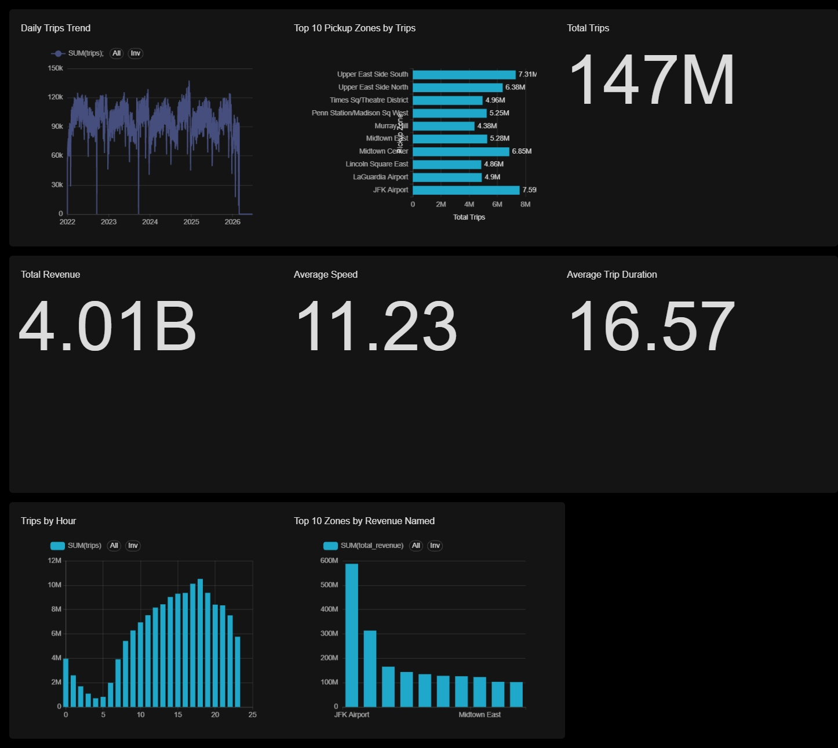
Superset Dashboard
VISUALIZATION LAYER
NYC TRAFFIC ANALYTICS · KPIs
≈147M
≈4.01B
Total Trips
Total Revenue
≈11.23
≈16.57
Average Speed (mph)
Avg Trip Duration (min)
CHARTS
FILTERS
Daily Trips Trend
Trips by Hour
Top 10 Pickup Zones by Trips
Top 10 Zones by Revenue
Time Range
Pickup Hour
Pickup Zone
Current results from our processed dataset, not universal NYC statistics.
Notes:
This is our Superset dashboard, NYC Traffic Analytics, shown with the real screenshot. It has four KPI cards: about 147 million total trips, about 4.01 billion total revenue, an average speed of about 11.23 and an average trip duration of about 16.57. Four charts: daily trips trend, trips by hour, top 10 pickup zones by trips and top 10 zones by revenue. Filters for time range, pickup hour and pickup zone make it interactive. Important: these are the results of our processed dataset, not universal NYC statistics.

Slide 14



Dashboard Insights
INSIGHTS
Top 10 pickup zones by trips (millions)
JFK Airport is the top pickup zone by trips (7.59M), ahead of Upper East Side South (7.31M)
Airport zones contribute significantly to revenue; JFK Airport leads the revenue chart
Trip volume varies strongly by hour: low in the early morning, highest in the evening
Pickup zones can be compared on both trips and revenue
Daily trip volume varies over time across the period shown
Values as labelled on the dashboard.
Notes:
What does the dashboard tell us? JFK Airport is the top pickup zone by trips, at 7.59 million, followed by Upper East Side South at 7.31 million. Airport zones also contribute significantly to revenue, with JFK Airport leading the revenue chart. Trip volume varies strongly by hour, with the lowest volume in the early morning and the highest in the evening. The dashboard lets us compare zones by both trips and revenue, and daily trips vary over time. The chart shows the labelled values from our dashboard; we do not claim anything beyond what is visible.

Slide 15




Machine Learning & Analytics
ANALYTICS EXTENSIONS
Mobility pattern analysis
Clustering
Trip prediction
ML experiments
sparkml_clustering.py
train_xgboost.py
Spark ML clustering for mobility pattern analysis
XGBoost model training for trip prediction experiments
train_trip_models.py
train_trip_models_no_distance.py
Trip prediction model training and comparison
Trip model variant trained without the distance feature
Experimental components that extend the pipeline; no model accuracy figures are claimed in this presentation.
Notes:
Beyond the main pipeline, the repository contains additional analytics and machine learning scripts. sparkml_clustering.py supports clustering and mobility pattern analysis. train_xgboost.py, train_trip_models.py and train_trip_models_no_distance.py support trip prediction experiments. These are experiments that extend the project, and we are not claiming specific model accuracy here.

Slide 16
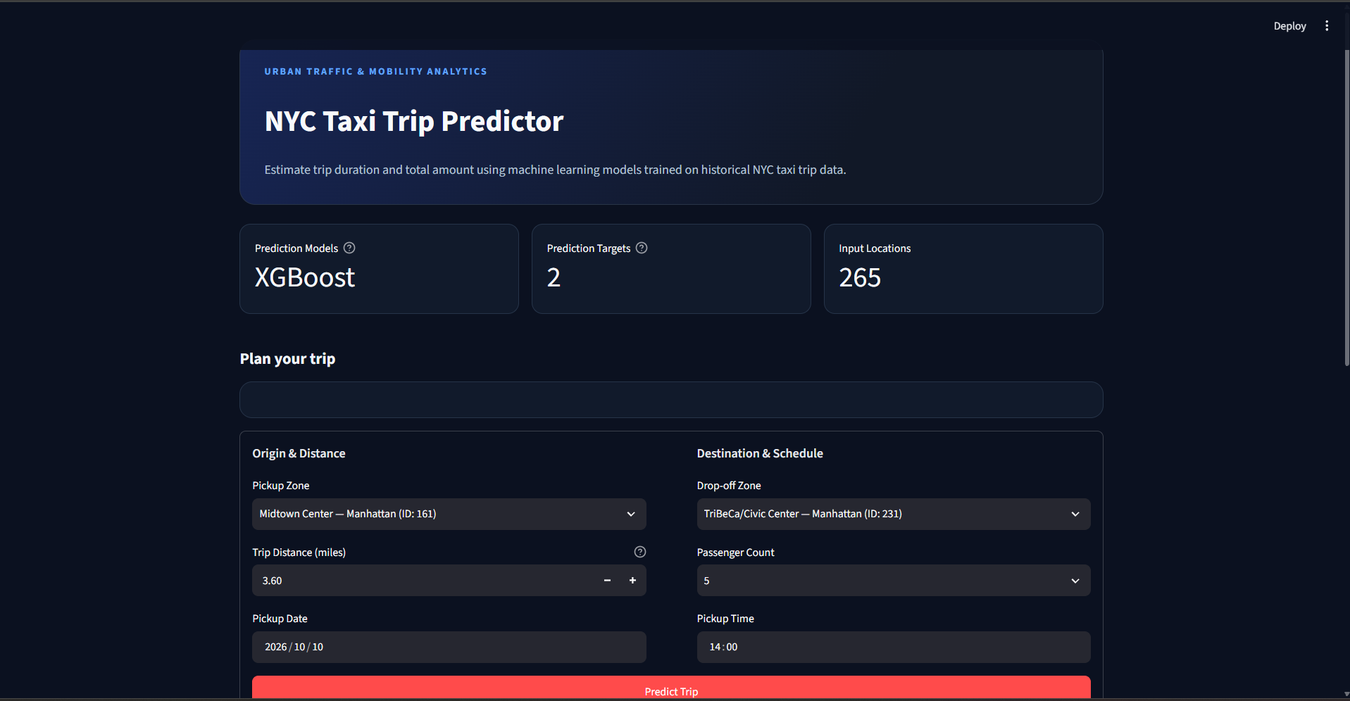
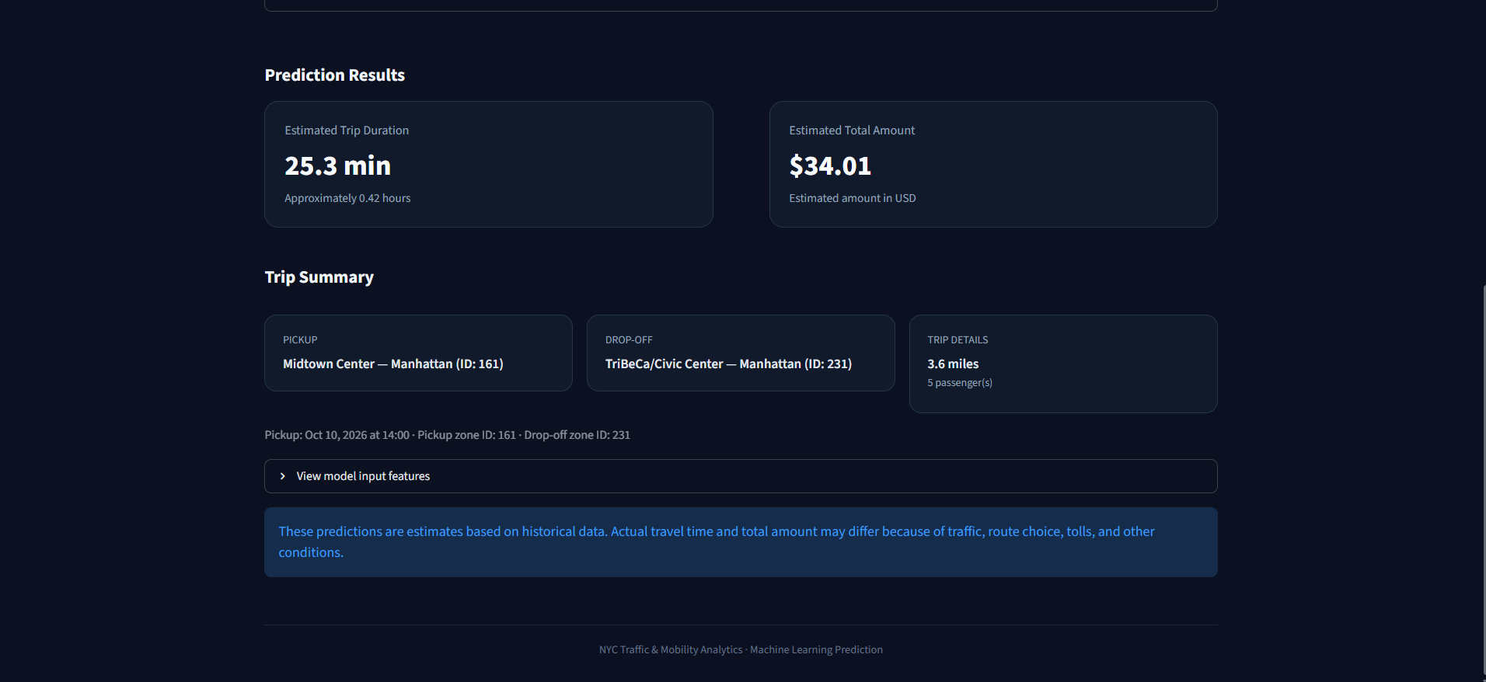
Streamlit – Trip Predictor App
ML APPLICATION
Inputs
Outputs
Model
Pickup and drop-off zone, trip distance, passenger count, pickup date and time
Estimated trip duration (minutes) and estimated total amount (USD)
XGBoost with 2 prediction targets and 265 input locations
Notes:
Besides the dashboard, we built an interactive web app with Streamlit: the NYC Taxi Trip Predictor. The user chooses a pickup zone, a drop-off zone, the trip distance, passenger count, and pickup date and time, then clicks Predict Trip. The app uses XGBoost models with two targets, estimated trip duration and estimated total amount, over 265 input locations. The screenshot shows one example prediction, for demonstration only; we are not claiming model accuracy, and the app itself states that predictions are estimates based on historical data.

Slide 17



Project Structure
REPOSITORY
nyc-traffic-bigdata/
├── airflow/
│ ├── dags/
│ │ └── nyc_traffic_pipeline.py
│ └── Dockerfile
├── clickhouse/
├── hadoop/
├── hadoop-config/
├── spark/
├── superset/
├── docker-compose.yml
├── app.py
├── etl_clean.py
├── etl_clean_staging.py
├── prepare_mahout_data.py
├── prepare_xgboost_data.py
├── sparkml_clustering.py
├── train_xgboost.py
├── train_trip_models.py
├── train_trip_models_no_distance.py
└── taxi_zone_lookup.csv
Orchestration
airflow/ with the DAG and Dockerfile
Services
clickhouse/, hadoop/, hadoop-config/, spark/, superset/ and docker-compose.yml
ETL & data
etl_clean.py, etl_clean_staging.py and taxi_zone_lookup.csv
App, ML & analytics
app.py (Streamlit), prepare_*, sparkml_clustering.py and train_* scripts
Notes:
This is the simplified structure of the repository. The airflow folder holds the DAG and its Dockerfile. The service folders and docker-compose.yml define the Big Data environment. The etl scripts and the taxi zone lookup file make up the ETL and data side. The prepare, sparkml and train scripts hold our machine learning and analytics experiments, and app.py is the Streamlit trip predictor.

Slide 18
Challenges & Solutions
LESSONS LEARNED
Running multiple Big Data services together
Docker runs the whole stack as isolated services
Managing Docker containers
A single docker-compose.yml starts and stops every service
Connecting Spark with HDFS
Spark reads and writes hdfs:// paths on the Docker network
Orchestrating ETL with Airflow
A DAG with pre-checks, ETL run and output validation
Handling large-scale Parquet data
Distributed Spark processing on columnar Parquet
Preparing analytical aggregations
Spark builds hourly zone-level aggregations (zone_hour)
Connecting ClickHouse with Superset
ClickHouse added as a Superset database; charts on zone_hour
Mapping numeric taxi zone IDs to names
Lookup join with taxi_zone_lookup.csv for readable names
Building interactive dashboard filters
Time range, pickup hour and pickup zone filters in Superset
Notes:
Building this pipeline came with realistic technical challenges. Running many Big Data services together and managing the containers was solved with Docker and a single compose file. Connecting Spark to HDFS, orchestrating the ETL with Airflow, and handling large Parquet data were solved through configuration, a validated DAG and distributed processing. We prepared hourly aggregations, connected ClickHouse to Superset, mapped zone IDs to names with the lookup file, and built interactive filters.

Slide 19

Project Results
OUTCOME
≈147M
≈4.01B
5 tasks
trips in the processed dataset
total revenue in the dashboard
automated in the Airflow DAG
End-to-end Big Data pipeline
Distributed storage using HDFS
Distributed ETL using Spark
Automated workflow using Airflow
Analytical storage using ClickHouse
Interactive visualization using Superset
Taxi zone name mapping
Interactive dashboard with filters
ML analytics and Streamlit trip predictor
Notes:
Here are the project results. We delivered an end-to-end Big Data pipeline: distributed storage in HDFS, distributed ETL in Spark, an automated Airflow workflow, analytical storage in ClickHouse and interactive visualization in Superset. We also mapped zone IDs to names, built an interactive dashboard, and added machine learning and analytics components. The numbers at the top are the current results of our processed dataset.

Slide 20



Future Improvements
ROADMAP
Real-time
Machine learning
Data & visualization
Deployment
Real-time streaming using Kafka
Real-time dashboards
More advanced machine learning models
Automated model retraining
Geographic visualization using NYC maps
Additional traffic and mobility datasets
Cloud deployment
Notes:
For future work, we see four directions. Real-time: streaming with Kafka and real-time dashboards. Machine learning: more advanced models and automated retraining. Data and visualization: geographic visualization on NYC maps and additional traffic and mobility datasets. And deployment: moving the platform to the cloud. None of these are part of the current pipeline.

Slide 21


Team & Instructor
TEAM
FS
ZS
MA
GT
Farouk Sameh
Ziad Sherif
Mostafa Ahmed
Gaber Tahoon
Project team
Project team
Project team
Project team
INSTRUCTOR
TRAINING
Ahmed Saeed
NTI – Huawei Egyptian Talents Academy
Big Data Track
Notes:
Our project team: Farouk Sameh, Ziad Sherif, Mostafa Ahmed and Gaber Tahoon. We completed this project in the NTI – Huawei Egyptian Talents Academy Big Data Track, under the supervision of our instructor, Ahmed Saeed. We would like to thank him for his guidance.

Slide 22
Thank You
NYC Traffic & Mobility Analytics
NTI – Huawei Egyptian Talents Academy
Big Data Track
Team: Farouk Sameh | Ziad Sherif | Mostafa Ahmed | Gaber Tahoon
Instructor: Ahmed Saeed
Notes:
Thank you for listening. To summarize: we built an end-to-end Big Data pipeline with HDFS, Spark, Airflow, ClickHouse and Superset, running in Docker, and delivered an interactive dashboard for NYC taxi analytics. We are happy to answer your questions.

